Slide 1
3D Bioprinting in Tissue Engineering for Medical Applications: The Classic and the Hybrid
By: Zelong Xie, Ming Gao, Anderson O. Lobo, and Thomas J. Webster
Guilherme Nasif
Notes:
Today, I’ll walk you through an overview of 3D bioprinting, including traditional and hybrid methods, focusing on their role in medical applications like tissue engineering and organ development. This is based on a review paper that synthesizes a broad body of existing research.

Slide 2

Purpose of a Review Paper
Summarizes, analyzes, and synthesizes the existing knowledge on a topic
Highlights trends, gaps, and emerging developments
Notes:
This presentation is structured like a review, bringing together various bioprinting techniques, materials, and applications to understand where we are today and where the field is headed.

Slide 3
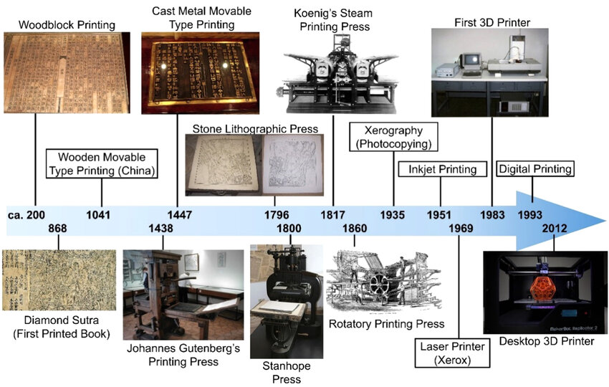
Background of Printing & 3D Technology
Originated with woodblock printing in ancient China
Additive Manufacturing (AM): builds 3D objects layer-by-layer
1986: Charles W. Hull introduces stereolithography
Bioprinting = AM + living cells + biomaterials
Notes:
3D printing has roots in ancient techniques, but its modern evolution with stereolithography and other methods opened new doors, particularly in biomedical engineering.

Slide 4
Additive vs. Conventional Manufacturing
AM: Layer-by-layer, customizable, great for complex geometries
CM: Material removal (cutting/molding), high precision and finish
Hybrid: Combines advantages of both
Notes:
Hybrid manufacturing aims to address the limitations of each approach by merging strengths — a concept we’ll revisit later in bioprinting.
For a detailed review of hybrid additive and subtractive machining, including the combination of computer numerical control machining with arc or laser based directed energy deposition, with additive cold spraying process, powder bed fusion, or material jetting.
By combining the two, researchers can create scaffolds that are both biologically realistic and structurally sound, meeting clinical demands for functional tissue substitutes.

Slide 5
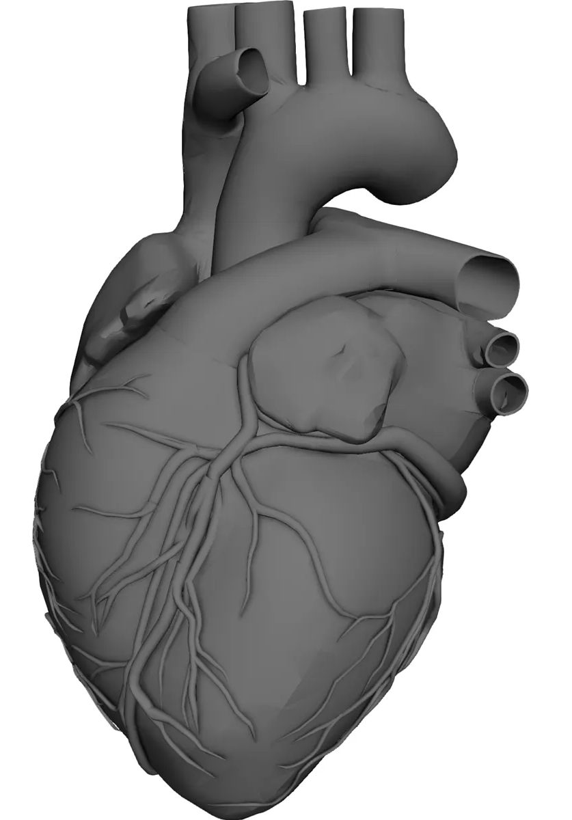
3D Printing Workflow
Create 3D CAD model
Slice into 2D layers
Build structure layer-by-layer
Post-processing (curing, cleaning, etc.)
Notes:
This foundational workflow underlies both standard 3D printing and bioprinting.

Slide 6
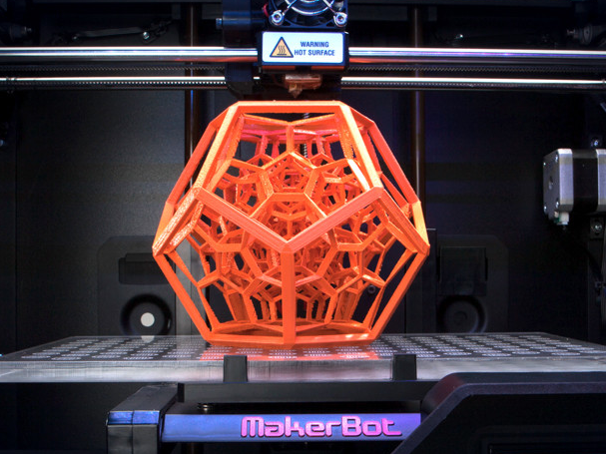
Non-Biological 3D Printing
They can still have biomedical applications if the right printing materials are selected
Methods:
Fused deposition modeling (FDM)
Stereolithography (SLA)
Selective laser sintering (SLS)
Notes:
While these additive manufacturing methods don’t print living cells, they are still incredibly important for medical applications such as prosthetics, surgical guides, and custom implants.

Slide 7
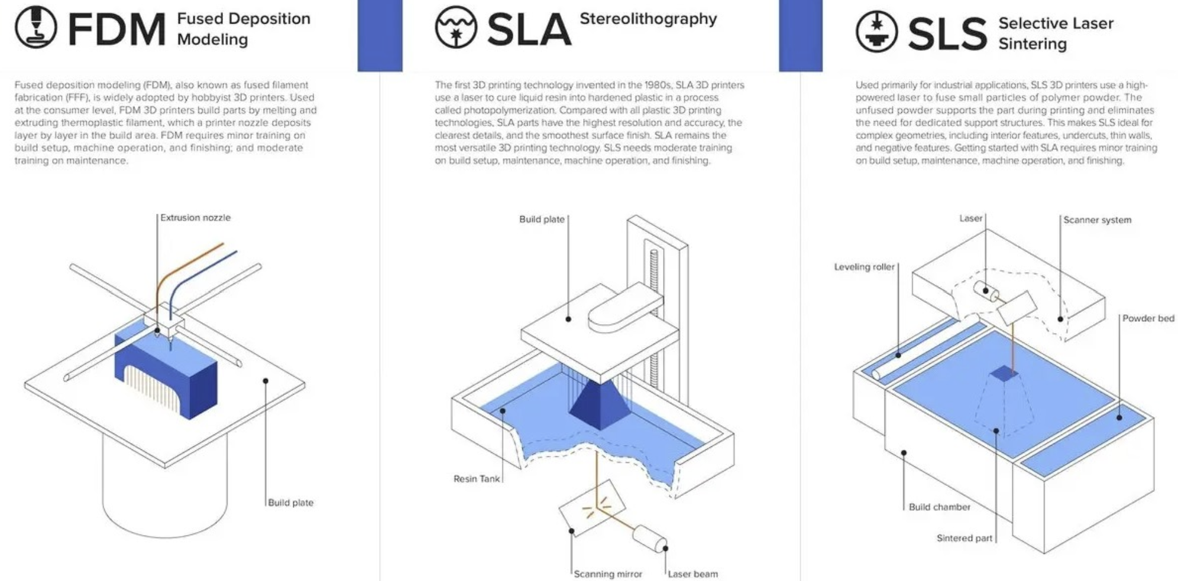
Notes:
Fused Deposition Modeling (FDM) is the most widely used AM technique. It works by heating and extruding a continuous filament of thermoplastic material onto a build plate, where it solidifies as it cools. FDM is affordable and accessible, but it's limited by the high temperatures required, which restricts material choice. Despite that, researchers have successfully printed bony scaffolds using polylactic acid (PLA) combined with hydroxyapatite (HA), achieving promising mechanical and biological properties. These scaffolds can even be customized with different porosity patterns and pore sizes.
Stereolithography (SLA) has been around since 1986 and was the first rapid prototyping method. It uses ultraviolet (UV) light or an electron beam to solidify layers of a photosensitive resin. Each layer is cured individually, then the build platform rises for the next resin layer to be cured on top. Once the print is complete, the excess resin is washed away. SLA is known for its extremely high resolution—it can create complex structures with internal geometries, and has achieved microfeatures as small as 0.6 micrometers. The main drawback is the limited number of biocompatible resins that work well with this process.
Selective Laser Sintering (SLS) is a powder bed fusion process. A thin layer of powder—typically a metal or polymer—is spread across a platform. A laser selectively fuses the powder in a 2D pattern. This process repeats layer by layer until the object is fully built. The resolution and performance depend on several factors: powder size, laser speed, laser intensity, and beam diameter. SLS is excellent for producing strong, porous metallic implants that encourage bone growth and integration. However, it also suffers from limited material availability.

Slide 8
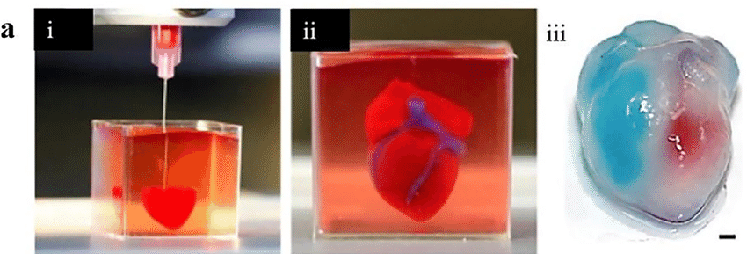
3D Bioprinting Methods
Direct deposition of living cells
Methods:
Inkjet bioprinting
Laser assisted bioprinting
Extrusion bioprinting
Notes:
Bioprinting techniques vary widely in resolution, cell viability, cost, and the types of materials they can handle. Some are more suited for precision, while others excel in speed and affordability.

Slide 9
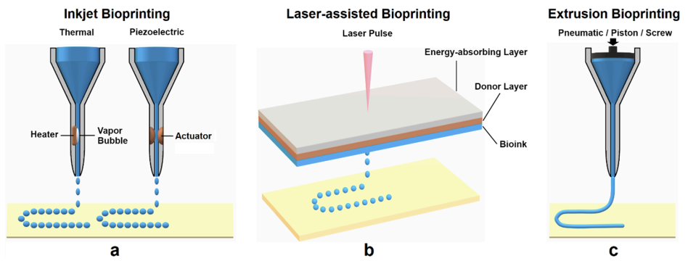
Notes:
Inkjet Bioprinting was the first technique developed. It uses bioink, typically a hydrogel pre-polymer solution containing encapsulated cells. The bioink is deposited onto a platform in droplets, layer by layer, forming precise patterns. There are two main methods of droplet generation:
One uses heat, which only slightly increases the temperature—safe enough not to damage cells.
The other uses electrical actuators to break the bioink into droplets.
Inkjet bioprinting is fast, low-cost, and highly accessible. In fact, a researcher named Orloff famously converted a standard office inkjet printer into a functional bioprinter. However, it has challenges, including droplet placement accuracy, nozzle clogging, and potential thermal stress on the cells.
Laser-Assisted Bioprinting (LAB) doesn’t use a nozzle. Instead, it prints from a ribbon structure made up of two layers: a top metallic layer (usually titanium or gold) that absorbs laser energy, and a bottom layer containing the bioink.
When a laser pulse hits the ribbon, part of the absorbing layer vaporizes, pushing a small amount of bioink downward as a droplet.
The absence of a nozzle reduces clogging issues and allows the printing of a wider variety of materials. However, LAB requires time-consuming ribbon preparation, especially when multiple cell types are involved. Also, laser effects on cell health are still being studied, and accurate droplet placement can be difficult.
Extrusion Bioprinting is currently the most economical and accessible bioprinting method, thanks to open-source projects like Fab@Home and RepRap. Unlike inkjet, extrusion is a mechanical process where material is continuously pushed through a nozzle. This allows more accurate placement of the bioink, and the printed material can also act as structural support for subsequent layers.
Extrusion bioprinting is especially useful for building tissue scaffolds. However, cell viability remains a challenge, ranging from about 40% to 86%. It typically uses hydrogels as support material, which can later be dissolved or removed with suitable solutions after the bioprinting process is complete.

Slide 10
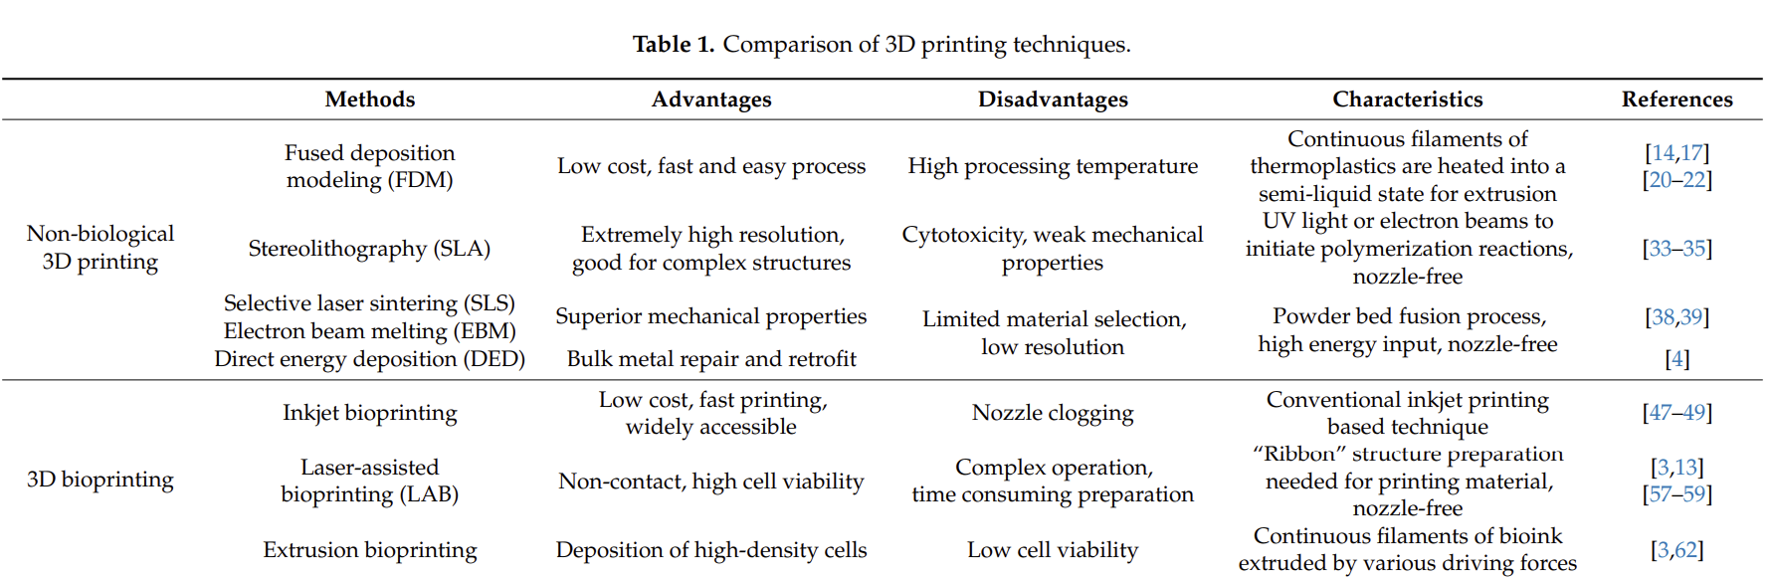
Comparison of 3D printing techniques
Notes:
They don’t necessarily point out the best option so far, but it sounds like laser assisted is the best method so far, since it has the biggest cell viability, but since the effects of the laser haven't really been studied it is hard to say.

Slide 11
Hybrid Bioprinting Approaches
Hybrid manufacturing combines Additive Manufacturing (AM) & Conventional Manufacturing (CM)
This very integrated into the metal industry
This same approach is now gaining traction in tissue engineering
Electrospinning is a technique used to create scaffolds, particularly with micro- and nanoscale fibers, that can support cell growth and tissue regeneration
Hybrid manufacturing can be integrated at different levels:
Assembly level – combining parts made separately by AM and CM
Fabrication level – merging different scales into one scaffold
Technique level – blending processes within one hybrid machine
Notes:
Hybrid manufacturing is the fusion of Additive Manufacturing (AM)—which builds structures layer by layer—and Conventional Manufacturing (CM), also known as subtractive manufacturing, which removes material to refine precision and surface quality.
In the metal industry, this integration is already used, often through CNC machining to post-process 3D-printed parts, improving surface finish and dimensional accuracy. More advanced systems now combine both processes within a single machine, bringing the spatial flexibility of AM together with the surface detail and speed of CM.
This same approach is now gaining traction in tissue engineering, particularly for scaffold fabrication. AM is excellent for building complex 3D shapes, but it struggles with sub-micron resolution, which is essential for mimicking the fine structures of natural extracellular matrix (ECM).
On the other hand, CM techniques—like electrospinning, gas foaming, and freeze-drying—can produce these micro- and nano-scale textures, but they lack the control over geometry, pore size, and connectivity that AM offers.
Electrospinning is a technique used to create scaffolds, particularly with micro- and nanoscale fibers, that can support cell growth and tissue regeneration
Electrospinning + Additive Manufacturing Integration
Electrospun fibers provide enhanced mechanical support and closely mimic the structure of native ECM.
When combined with AM, they allow precise control over microstructure, external geometry, and pore size.
This hybrid method supports cell migration and engraftment by creating interconnected porous environments.
Hybrid manufacturing can be integrated at different levels:
Assembly level – combining parts made separately by AM and CM
Fabrication level – merging different scales into one scaffold
Technique level – blending processes within one hybrid machine

Slide 12
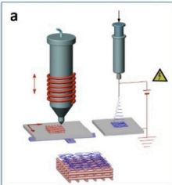
Assembly Level: Separate Modules Joined Together
Multiphasic scaffolds combine multiple materials, structures, and biofunctions
Enable complex tissue regeneration at functional interfaces (e.g., bone–ligament)
Commonly integrate AM (solid phase) and electrospinning (soft ECM-like phase)
Example: Biphasic scaffold for alveolar bone/periodontal ligament regeneration
AM scaffold for bone support
ES membrane for fibroblast adhesion & ligament integration
Surface-modified implants (FDM + ES coatings) enhance cell attachment & viability
Over 90% viability with PVA-nHA nanofiber coatings
Notes:
Multiphasic scaffolds represent a highly advanced and functional approach in tissue engineering, particularly for regenerating multiple types of tissues at once, such as bone and ligament.
These scaffolds contain distinct compartments, each with unique topologies, materials, and cell compatibility, tailored to meet the mechanical and biological needs of specific tissues.
Typically, the solid phase is created via Additive Manufacturing (AM) for structural support, while the soft phase—which mimics the extracellular matrix (ECM)—is fabricated using electrospinning (ES).
One prominent example is from Vaquette et al., who created a biphasic scaffold to regenerate both alveolar bone and periodontal ligament. The AM component supported bone formation, while the ES membrane facilitated fibroblast attachment and ligament development. In animal trials, these constructs showed successful tissue integration and stability with no signs of inflammation.
Another example by Saniei et al. shows how FDM-printed implants can be coated with nanofibers (using ES) to enhance surface biocompatibility. PLA screws coated with PVA-nHA fibers supported excellent cell growth—over 90% viability within a week.
These results highlight how hybrid fabrication methods are paving the way for creating clinically viable, functionally layered tissue constructs that better mimic the complexity of real biological systems.

Slide 13
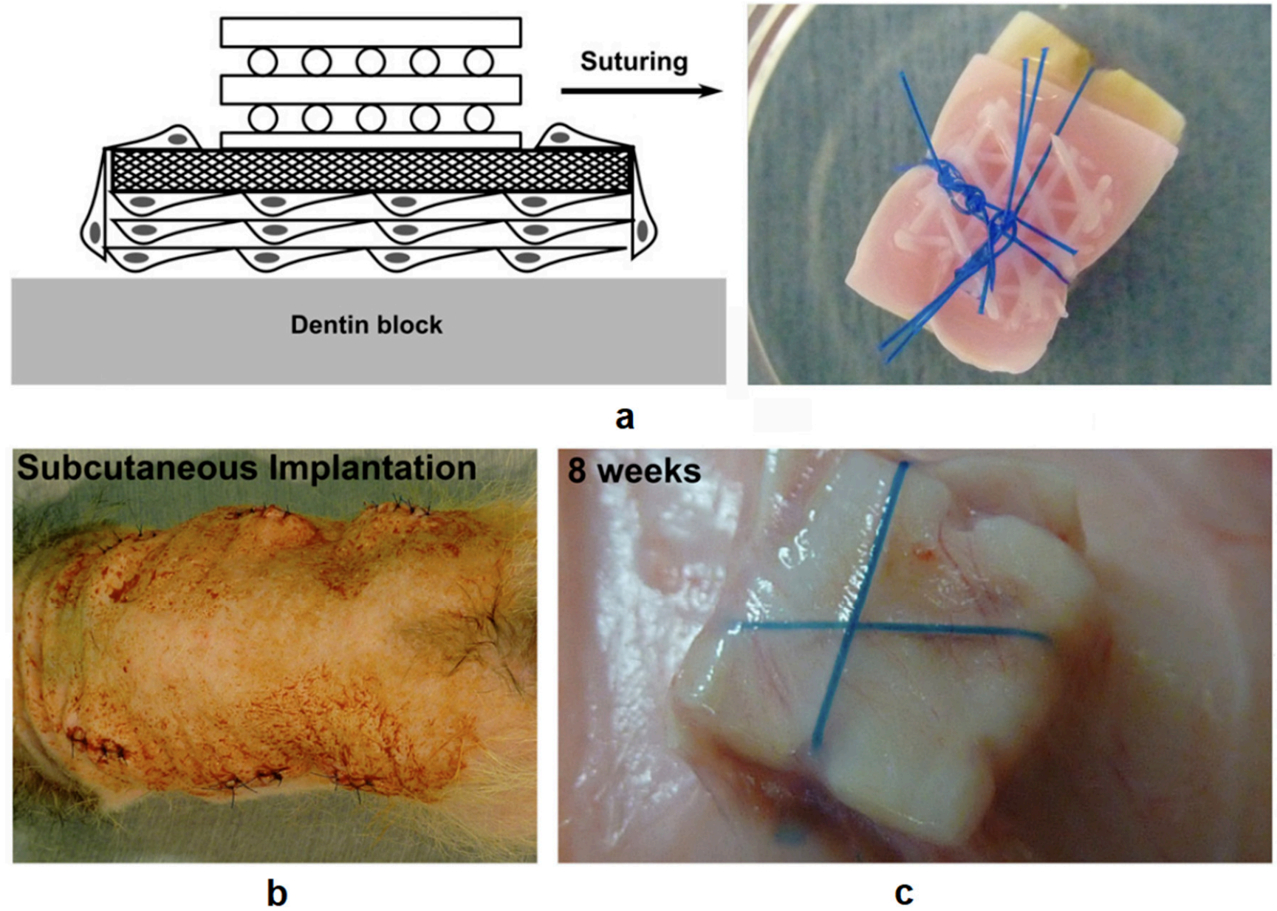
Notes:
Demonstration of the assembling a biphasic scaffold onto a dentin block
Illustration of subcutaneous implantation in athymic rats
The tissue integration results after 8 weeks after implantation

Slide 14
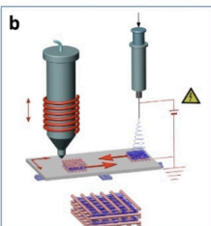
B) Fabrication Level: Merging Different Scales into one Scaffold
Cell seeding efficiency is limited by AM’s low resolution
Hybrid scaffolds integrate submicron CM features (e.g., electrospun fibers) into AM structures
Benefits:
Better cell entrapment, proliferation, and ECM production
Improved biochemical signaling and microenvironments
Example:
Glycosaminoglycan (GAG) content doubled when electrospun layers added to AM scaffolds
Techniques used:
Electrospinning, freeze-drying, electrostatic self-assembly, FDM + ES embedding
Notes:
One of the main challenges in 3D bioprinting is improving cell seeding efficiency, which is crucial for successful tissue regeneration. The relatively low resolution of additive manufacturing (AM) often limits the micro-scale cues that cells rely on for attachment and differentiation.
A promising solution is integrating high-resolution submicron structures made by conventional manufacturing (CM)—like electrospun fibers—into the larger AM-printed scaffold. This hybrid approach provides mechanical support through AM while mimicking the native extracellular environment through CM.
In one notable study by L. Moroni et al., researchers alternated AM-printed macrofiber layers with electrospun nanofiber layers. The result was a scaffold with significantly improved biological performance. For example, glyco-samino-glycan (GAG) levels—a key indicator of cartilage formation—doubled in hybrid scaffolds compared to AM-only ones.
Another study embedded aligned Poly-ca-prolactone (PCL) nanofibers into FDM-printed Poly-lactic Acid (PLA) frames. These hybrid constructs enhanced cell orientation, attachment, and mechanical properties, demonstrating the ability to replicate native tissue structure and function.
Additional methods like freeze-drying and electrostatic self-assembly have also been used to introduce more native-like microenvironments within AM frameworks. In some designs, miniature AM-printed elements were inserted into soft scaffolds for targeted structural support.
Ultimately, these integrated techniques enable more biomimetic tissue scaffolds and open the door for more effective regenerative therapies.

Slide 15
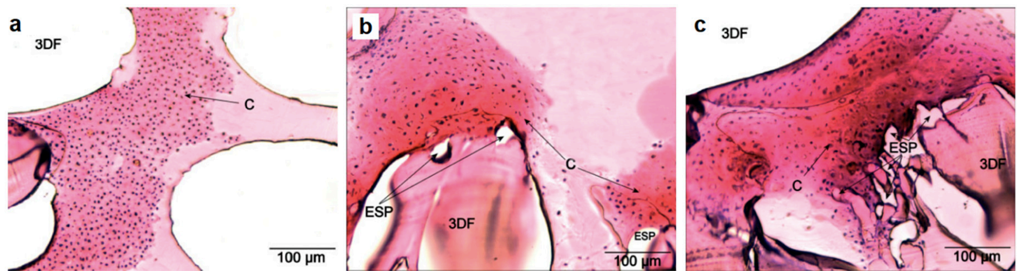
Notes:
3D fiber decomposition (3DF) scaffolds - 160 microgram
Samples prepared by extrusion based 3D bioprinting of microfibers using FDM prepared PLA frames (polylactic acid)
3D fiber decomposition and electrospun (3DFESP-30) scaffolds (electrospinning microfibers for 30 seconds between every two 3D fiber deposited layers) - 321 microgram
A hybrid scaffold was fabricated by embedding electrosupn aligned polycaprolactone (PCL) nanofibers between FDM prepared PLA frames.
3DFESP -2 scaffolds are the same method as B but spun for 2 minutes instead of 30 seconds and had - 316 micrograms
“C” indicates cartilage formation (GAG)
3DF refers to macro fibers
ESP refers to microfibers

Slide 16
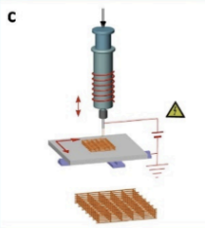
C) Technique Level: Blending Processes Within One Hybrid Machine
Limitations of AM:
Incompatibility with porogen leaching and local-pore techniques
Solutions & Innovations:
AM-compatible porogen systems and indirect AM methods
Freeze-drying + AM: Combines micro- & submillimeter pores for better cell adhesion
Techniques:
LFDM, LDM, cryogenic direct-plotting, RFP
Example: Cryo-printed collagen scaffold with >96% porosity and strong cell migration
Other novel methods:
Computer-assisted wet spinning (CAWS): Spongy, bioactive structures
Melt electrospinning direct writing: High-resolution fiber deposition
Notes:
While additive manufacturing (AM) is powerful, it faces a key limitation: most methods don’t support local-pore fabrication or standard porogen leaching, which are critical for creating porous structures that mimic real tissue architecture.
To overcome this, researchers have developed AM-compatible porogen systems and indirect AM techniques that better support the formation of biomimetic porosity.
A major innovation is the integration of freeze-drying with AM processes. This allows the simultaneous creation of both micro- and submillimeter pores, providing more surface area for cell adhesion, migration, and nutrient exchange.
A notable example is from Yen et al., who used liquid-frozen deposition manufacturing (LFDM) to extrude PLGA solutions and control scaffold surface topology. Related methods like LDM, RFP, and cryogenic direct-plotting have also proven effective—especially in fabricating collagen scaffolds with over 96% porosity and excellent cell migration and differentiation, verified by histological staining.
Another innovation is the computer-assisted wet spinning (CAWS) method. It involves depositing polymers in a condensation bath, creating a spongy structure via phase inversion, which enhances biological performance.
Lastly, melt electrospinning direct writing merges high-resolution fiber control with AM, offering another pathway for custom scaffold design.
These advancements represent a crucial evolution in scaffold fabrication—enabling precise control over porosity, structure, and biological functionality essential for tissue engineering success.

Slide 17
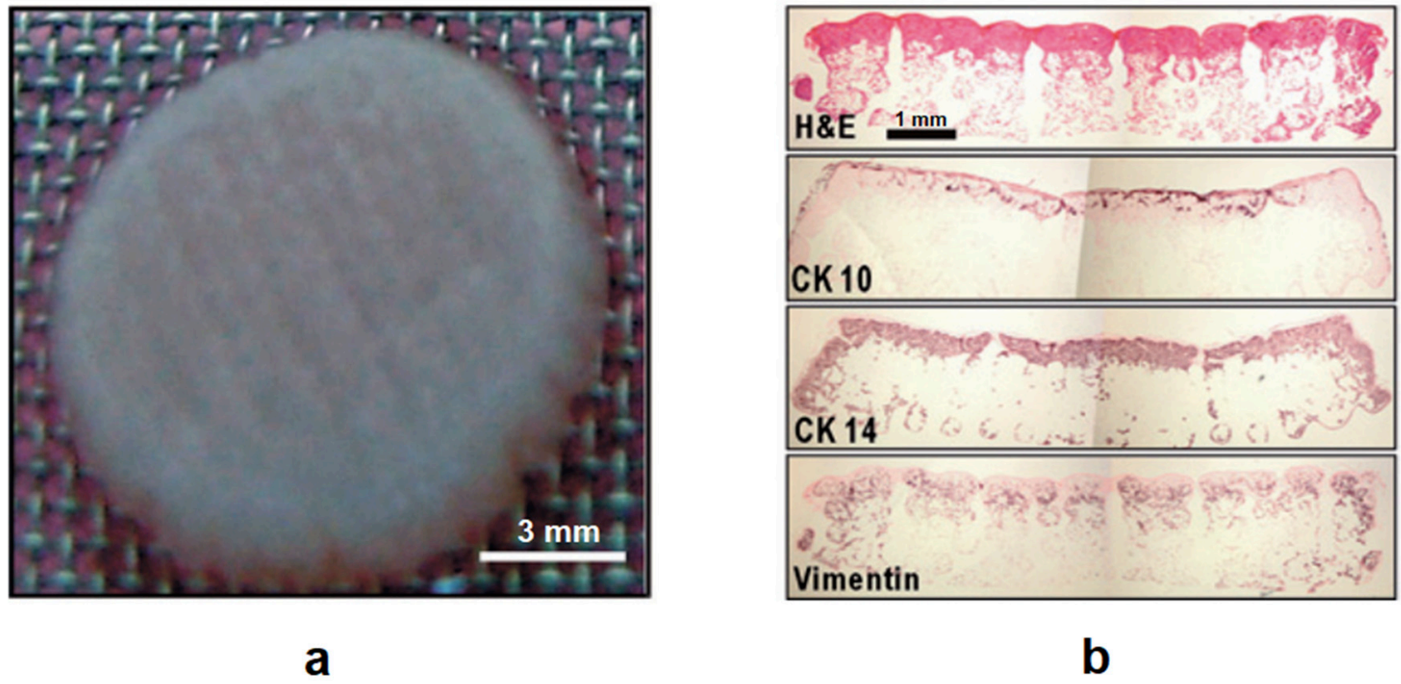
Notes:
Optical image of a collagen scaffold after cell culturing with keratinocytes and fibroblasts
Cross sections with hematoxylin and eosin staining (top) and immunohistochemical detection of cytokeratin (CK10) and (CK14) (middle), vimentin (bottom)

Slide 18
Materials for Bioprinting
Printability: accurate, controlled deposition
Biocompatibility: integrates safely, degrades in sync with tissue regeneration
Mechanical Properties: maintains structure for cell attachment
Material Types:
Natural polymers: collagen, alginate, fibrin, etc.
Synthetic polymers: customizable but less biocompatible
dECM: mimics native tissue
Notes:
The choice of material in bioprinting is one of the most critical decisions—it directly affects printability, biological functionality, and overall success of the scaffold or tissue.
Key Material Considerations
Printability: How well a material can be deposited accurately and controllably. This varies depending on the printing technique—there’s no one-size-fits-all solution.
Thermal & Mechanical Behavior: Materials with low thermal conductivity and the ability to cushion cells during deposition help maintain high cell viability.
Mechanical Properties: Once printed, materials must support the 3D structure and withstand vertical tension. This is sometimes enhanced by coating the substrate with a supportive layer.
Biocompatibility: The material must work harmoniously with the host tissue—it should degrade at a rate that matches the host’s ability to replace it with its own ECM proteins.
Materials should be non-toxic, rapidly metabolized, and quickly cleared from the body after performing their function.
Natural vs. Synthetic Materials
Natural polymers like collagen, gelatin, laminin, fibronectin, alginate, chitosan, fibrin, and hyaluronic acid offer biological realism. They mimic the native extracellular matrix (ECM) and are already well established in tissue engineering.
Synthetic polymers, on the other hand, provide greater control and customization. They offer precise printability and can be engineered to meet specific needs. However, they’re not ideal for long-term cell viability.
Decellularized ECM (dECM)
One especially promising natural material is dECM—decellularized extracellular matrix.
It retains important biochemical cues from real tissues, which can help guide cell behavior, differentiation, and tissue regeneration.
dECM-based bioinks can be tailored for specific organs or tissues and better simulate native biological environments.

Slide 19
Cell Sources in Bioprinting
Multiple cell types often needed
Must maintain:
High initial proliferation
Long-term homeostasis
Patient-derived cells reduce immune rejection
Notes:
Cell Sources
Multiple cell types are usually required during fabrication, each fulfilling specific and essential biological functions.
At early stages, high proliferation is ideal to encourage tissue growth.
Over time, however, the goal is to achieve homeostasis—a balanced rate of proliferation to prevent uncontrolled growth (hyperplasia).
For clinical use, autologous cells—those taken from the patient—are preferred to minimize immune rejection risks.

Slide 20
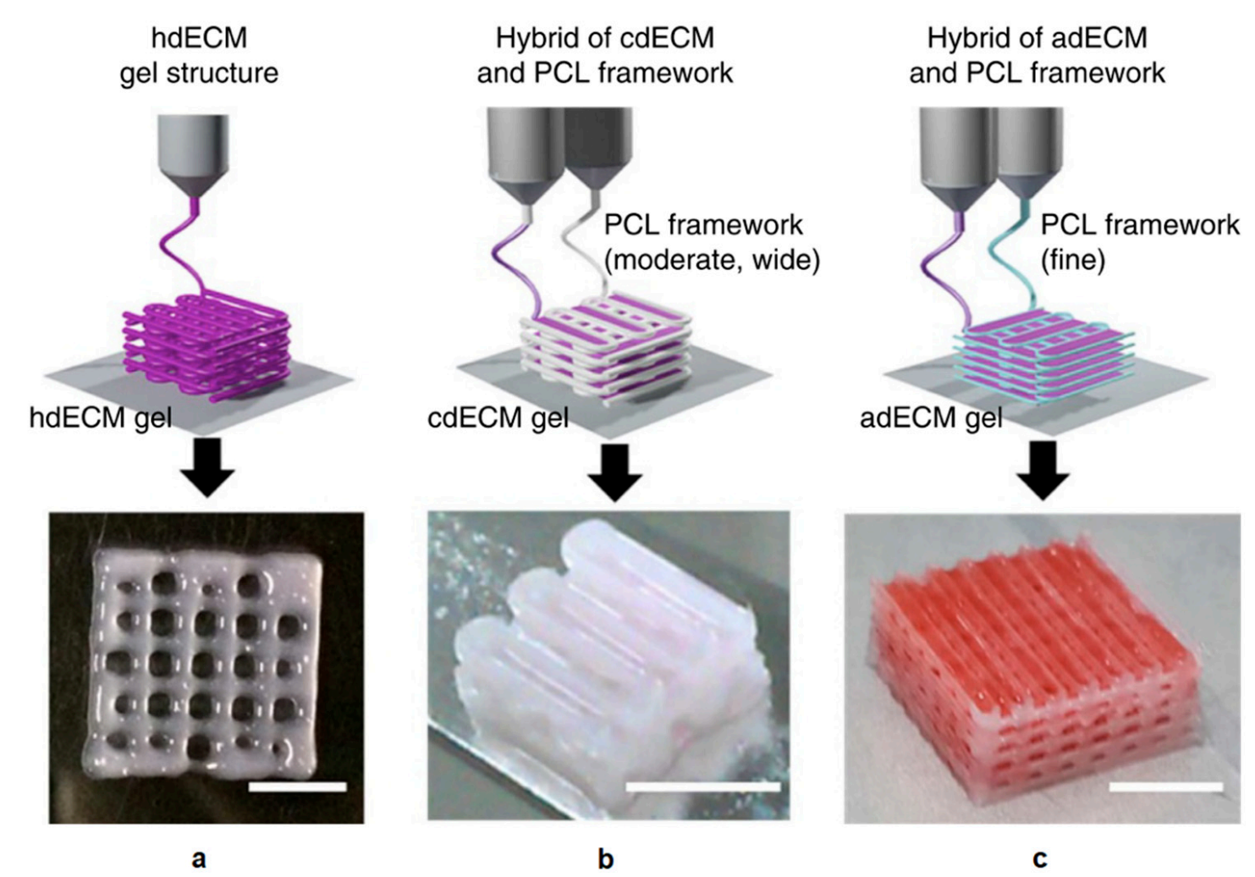
Notes:
Bioprinted heart tissue with only the heart dECM (hdECM)
Printed cartilage (flexible connective tissue) dECM (cdECM) and PCL (polycaprolactone) framework, it is biodegradable material
Printed adipose (tissue for the storage of fat) tissue with adipose dECM (adECM) and PCL framework (scale bar, 5mm).

Slide 21
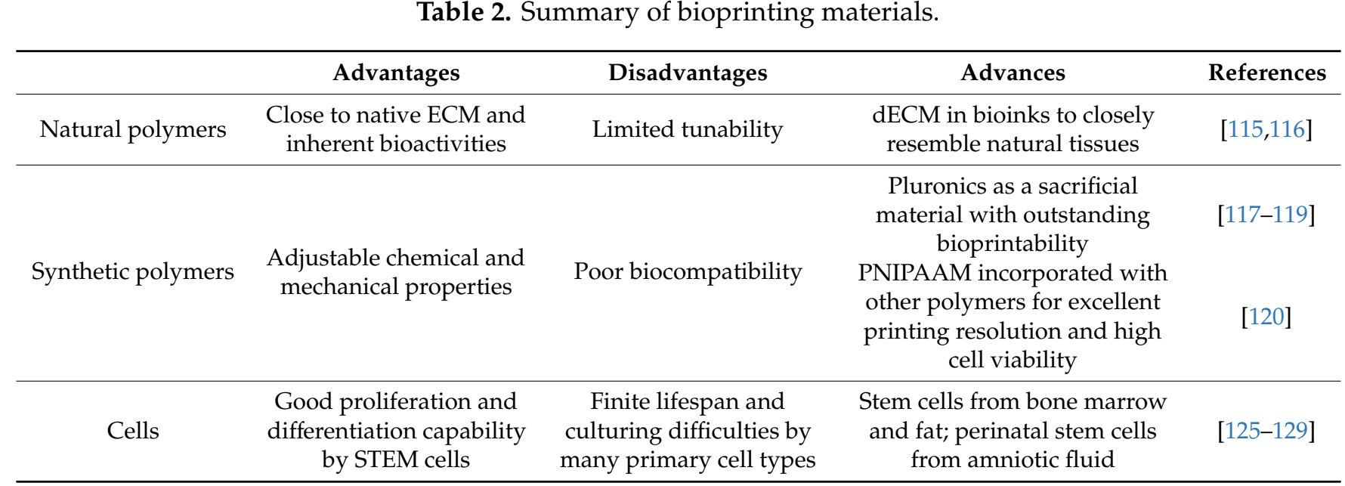

Slide 22
Medical Applications
Tissue Regeneration:
Blood vessels, heart valves, bones, cartilage, liver, nerves, and skin
Notable progress in vascular channels & tri-leaflet heart valves
Bone & Cartilage Engineering:
Bioprinted scaffolds with ECM, calcium phosphates, and CAP treatments
High structural accuracy and enhanced cell interaction
Skin & Liver Fabrication:
LAB-based layered skin grafts with fibroblasts and keratinocytes
Bioprinted liver tissue using hepatocytes; preserving function is challenging
Drug Discovery & Screening:
Bioprinted microenvironments mimic real tissue
Enables toxicity, metabolism, and disease pathophysiology testing
Notes:
3D bioprinting is revolutionizing both regenerative medicine and biomedical research with its ability to precisely fabricate biologically functional tissues.
First, in tissue regeneration, we’re seeing significant strides in printing blood vessels and heart valves. For example, vascular networks made with GelMA and sacrificial materials like Pluronic F127 have shown improvements in nutrient transport and structure. Similarly, aortic valve scaffolds using hybrid methods like FDM and electrospinning have demonstrated promising mechanical performance
In bone and cartilage applications, bioprinting offers fine architectural control. Scaffold materials like BCPs, PCL, and b-TCP combined with techniques like plasma surface modification or ECM ornamentation improve both structural integrity and cell compatibility. Cartilage regeneration also benefits from new hydrogels with excellent bioprintability and low immune response.
For skin and liver, printed constructs now support cell proliferation and integration. Skin-like tissues printed with fibroblasts and keratinocytes have been successfully tested in mice. Liver printing still faces challenges in maintaining long-term cell viability, but bioink innovations and on-site printing during surgeries are offering new solutions.
Lastly, in drug discovery, 3D bioprinting enables the development of platforms that mimic real tissues, improving how we study drug toxicity and efficacy. This includes liver models for metabolism studies and skin tissues seeded with disease-specific cells for pathophysiology analysis.
Overall, 3D bioprinting is a transformative tool with applications that span from lab testing to patient-specific tissue implants.

Slide 23
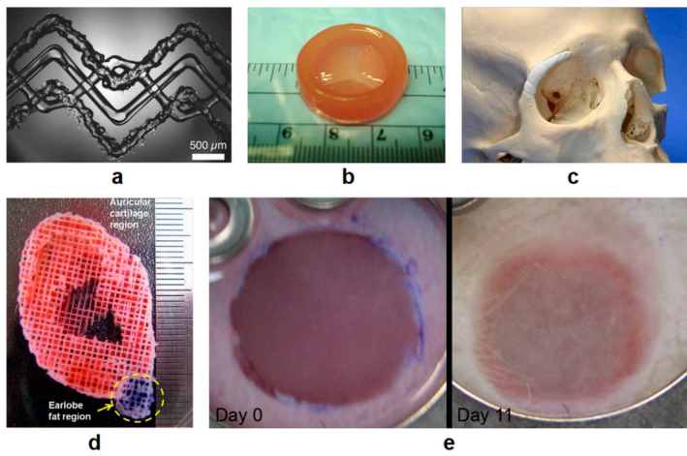
Notes:
Bright field microscopy image of a 3D printed vascularized and heterogeneous tissue construct
3D printed heart valve conduit
3D printed and inserted BCP implant with adequate fitting
Acellular fabricated ear shaped structure using 3D bioprinting technology with the sacrificial layer process, auricular cartilage region (red color) and lobe fat region (blue collar)
Tissue engineered skin construct in the dorsal skinfold chamber in nude mice

Slide 24
Challenges in Bioprinting
Technical Challenges:
Limited resolution (typically >50 μm); nanoscale precision needed
Slow print speeds hinder scalability & bioink stability
Hybrid printing needs milder, cell-safe conditions
Material Challenges:
Bioinks must balance biocompatibility with mechanical strength
Limited variety of printable biomaterials
dECM offers biomimicry, but often lacks structural support
Cellular & Biological Hurdles:
Cells must survive printing, grow rapidly, & avoid immune rejection
Advances in small molecule use show promise for directed differentiation
Ethical & Regulatory Concerns:
DIY/home bioprinting risks & potential for bioterrorism
Lack of global regulatory frameworks for clinical use
Patient-specific ethics: testing customized organs on others?
Notes:
While 3D bioprinting holds tremendous promise, its widespread adoption faces several challenges.
Technically, one major limitation is printing resolution—inkjet and extrusion-based printers can't go below 50 microns due to nozzle size. Laser-assisted printing improves this but still can't reach subcellular levels. Yet, to precisely arrange biomolecules like growth factors, nanoscale accuracy is essential.
Printing speed is another issue, especially for large-scale clinical applications. Long print times can compromise the viability and functionality of bioinks and the structural stability of in-progress builds. Innovations like multi-head printers and CLIP (Continuous Liquid Interface Production) are helping, but more work is needed.
On the materials front, current bioinks often force a trade-off between biological activity and mechanical strength. For example, dECM bioinks are great for mimicking natural tissue environments but typically need support from stronger, less bioactive materials like PCL. There's also a very limited palette of printable biomaterials, especially for hybrid approaches.
Biologically, the challenge lies in finding or engineering cells that can withstand the printing process, grow rapidly, function properly, and not provoke immune responses. Small molecule research offers hope in guiding controlled cell differentiation.
Ethically and legally, 3D bioprinting is ahead of regulation. Widespread access raises fears of DIY misuse. There's also the question of who clinical trials should be tested on—how ethical is it to use a patient’s custom organ on someone else? Or should patients act as their own trial subjects?
While countries like South Korea and Japan have begun shaping guidelines, a comprehensive global regulatory framework is still lacking. This will be essential to ensure safe, equitable, and ethical use of this groundbreaking technology.

Slide 25
Conclusion
Proven potential in regenerative medicine, transplantation, and drug discovery
Advanced technique for building functional 3D biological structures
Hybrid bioprinting enhances resolution, strength, and biological realism
Continued progress needed in technology, materials, and regulatory frameworks
Still emerging, but holds transformative potential for healthcare and manufacturing
Notes:
To conclude, 3D bioprinting has already demonstrated remarkable potential in several key areas, from tissue regeneration and organ transplantation to pharmaceutical testing and personalized medicine.
Its ability to fabricate complex, functional structures with precise biological, mechanical, and architectural features is a game-changer for modern healthcare.
Emerging hybrid approaches—which combine 3D printing with traditional manufacturing—have pushed the field even further. These systems can deliver higher resolution, more durable constructs, and better mimic the body's natural environment to support real cell behavior.
However, the technology is far from complete. We still need improvements in printing methods, a broader selection of bioinks, and especially stronger regulatory systems to guide safe and ethical use.
Despite these ongoing challenges, 3D bioprinting remains one of the most promising and disruptive technologies in medicine, with the power to reshape how we approach healing, treatment, and biological manufacturing in the near future.

Slide 26
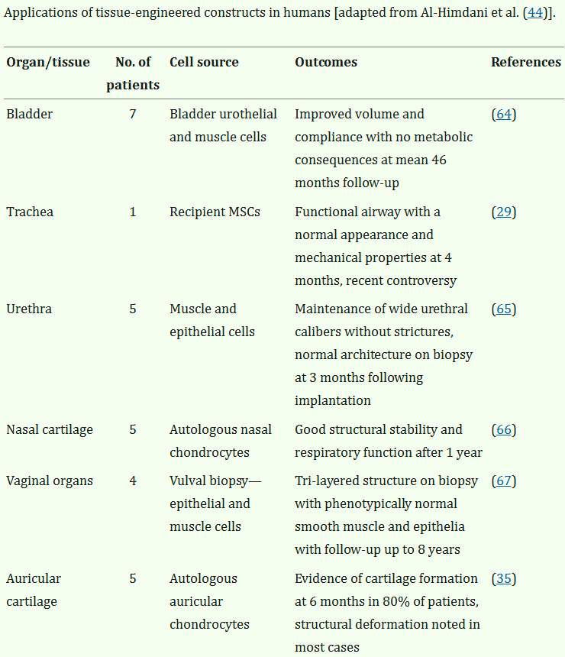
Fun facts & Questions?
First bioprinted organs?
The first bioprinted organ successfully transplanted into a human was a bladder, created in 1999 by scientists at the Wake Forest Institute for Regenerative Medicine.
How many bioprinted implants used so far?
6 different organs in 27 different patients

